Slide 1

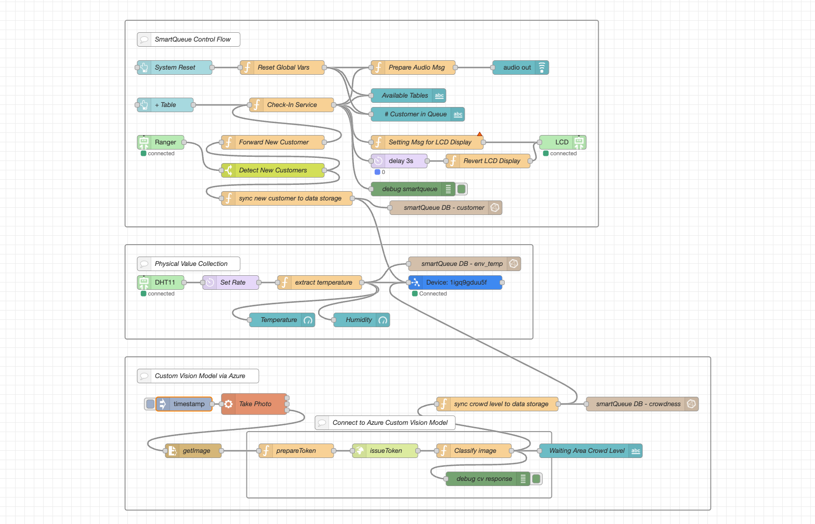



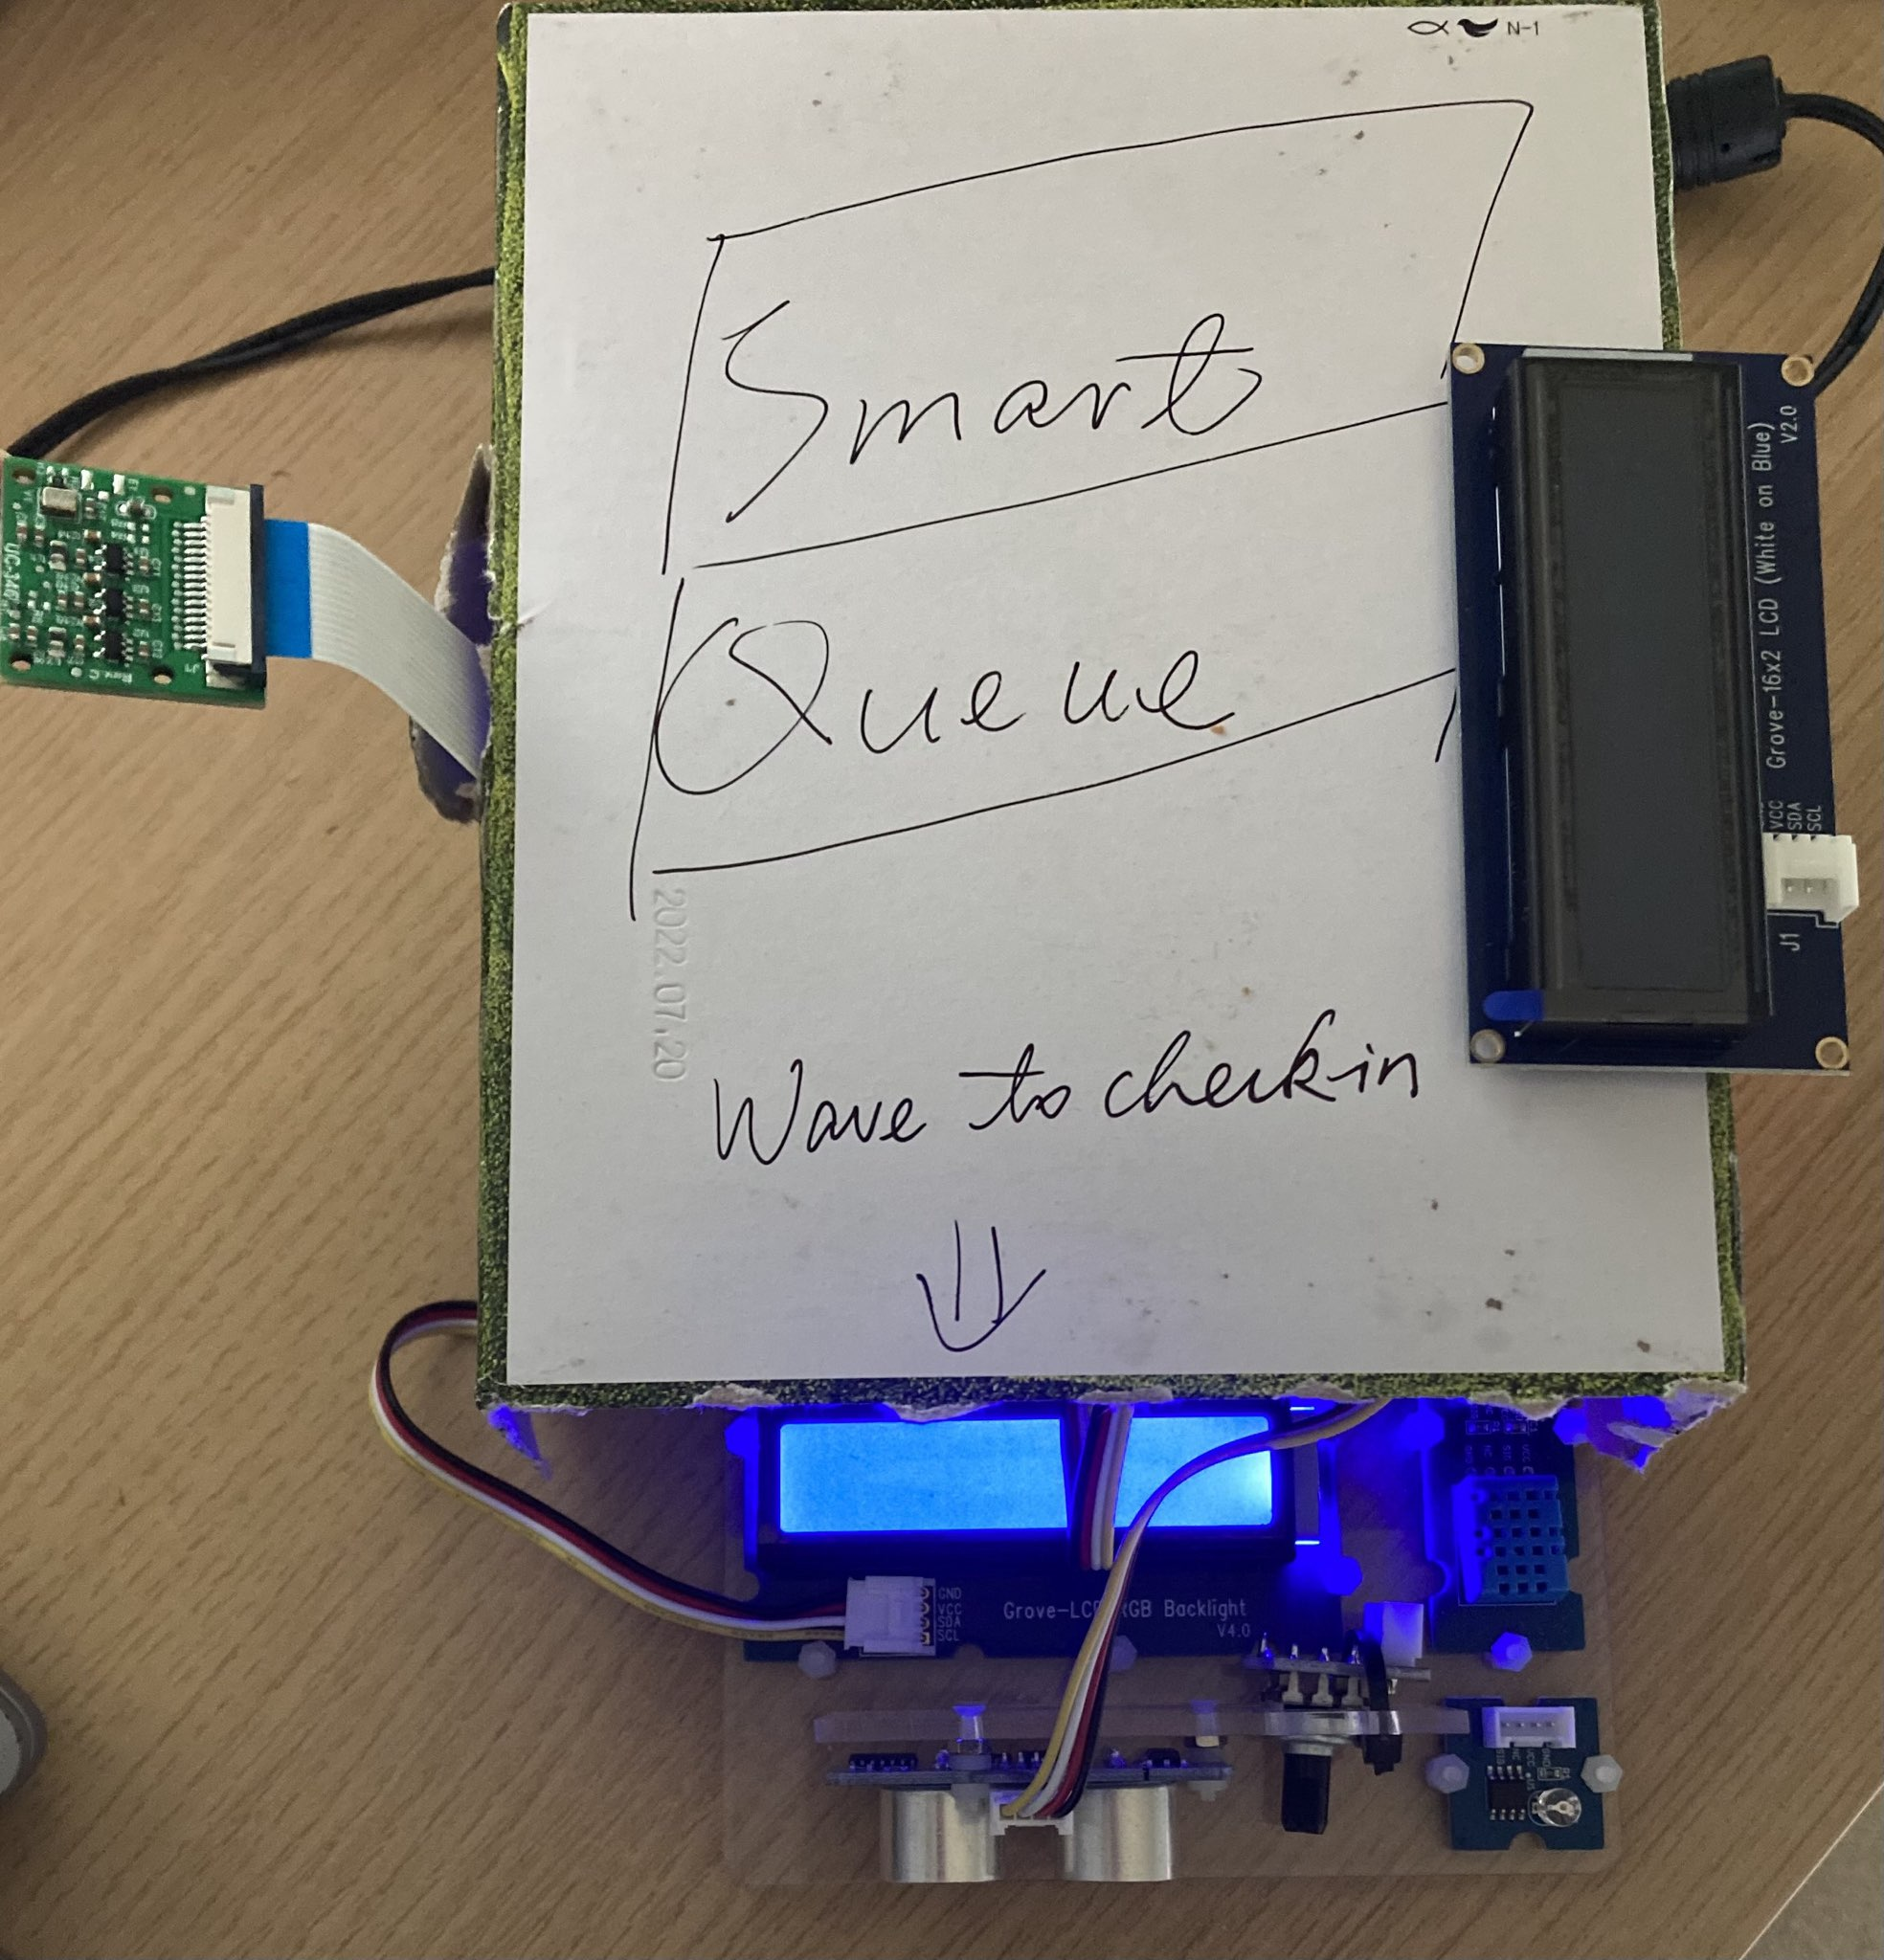
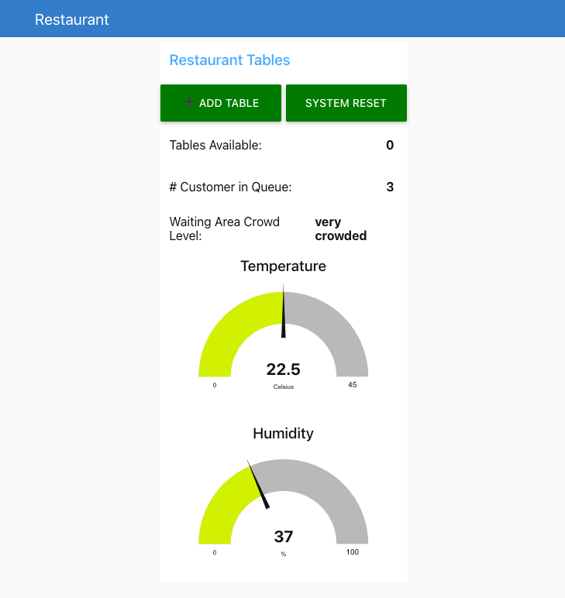
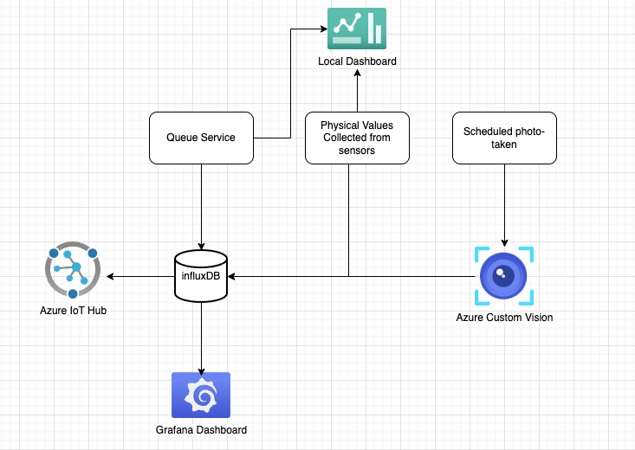
Smart Queue System
Group Members: Bryan Chen, Phuoc Le
University of Washington
Project Idea
Technologies Employed
Node-RED Flows
Problem:
Small businesses such as clinics, salons, and restaurants often face challenges with manual queue management, leading to inefficiency, long waiting times, and customer dissatisfaction. Our Smart Queue System aims to address these issues by providing a lightweight, cost-effective IoT-based solution for managing queues digitally.
Customers can register their position in the queue through a touchless sensor, and receive alerts when it’s their turn. Additionally, businesses can use an optional dashboard to track queue statistics and optimize their workflow. Challenges: – There were so many times our design undergo changes because new ideas keep popping up during the work. – The lack of data to train model for ai recognized. – Ensuring smooth connection between services. – Ensuring business logic works for all cases. Proposes Solution: Smart Queue System aims to make it convenient for restaurant to operate smoothly and take less time to manage it. Ultrasonic sensor is used to register customer waiting the the queue and using LCD display to let the customer know when is it their turn. Camera is used to predict and suggest if the restaurant might need more staff to help. There are other devices such as dht11 used in the project to assist restaurant as well.
Edge Technologies:
– Raspberry Pi and camera for image capturing.
– Ultrasonic sensor used in touchless check-in process for customers.
– Temperature and humidity sensor for environment condition monitoring.
– Wi-Fi module for internet connectivity and data exchange.
– InfluxDB for edge data storage.
– Grafana for local dashboard.
– Node-RED for programming main functionalities and use of dashboard.
Cloud Technologies:
– Azure Custom Vision Service.
– Azure IoT Hub for cloud dashboard and data analysis.
Below is the node-red flow:
High Level Overview (Architecture)
Project Outcomes
Prototype
As shown in the Node-RED flow, the Smart Queue System contains three parts:
– Queue Management Service: Logic for maintaining the queue and updating customers about their check-in status
– Physical Values Collection Service: Collecting the temperature, humidity and heatIndex values and sending them to data storage service.
– Computer Vision Service: Scheduled photo-taken that using Azure Custom Vision Model to classify the crowd level of the waiting area.
Smart Queue System:
– Auto Register Customer when they activate it by waving hand in front of the sensor which will save a lot of time.
– Suggestion for “busy time” when there are many people in the queue. Dashboard will suggest that might need more staff call in to help out
– Fast and easy to use: customer only need to wave hand to register and get their number
– Simple and friendly Dashboard: There is only 2 buttons. One is used to add available table when a customer left and the other button is for reset everything after a day or so.
References
NodeRed: https://nodered.org
Raspberry Pi: https://www.raspberrypi.com
GrovePi: https://www.dexterindustries.com/grovepi
InfluxDB: https://www.influxdata.com
Microsoft Azure Custom Vision: https://azure.microsoft.com/en-us/products/ai-services/ai-custom-vision
Grafana: https://grafana.com/

